Slide 1

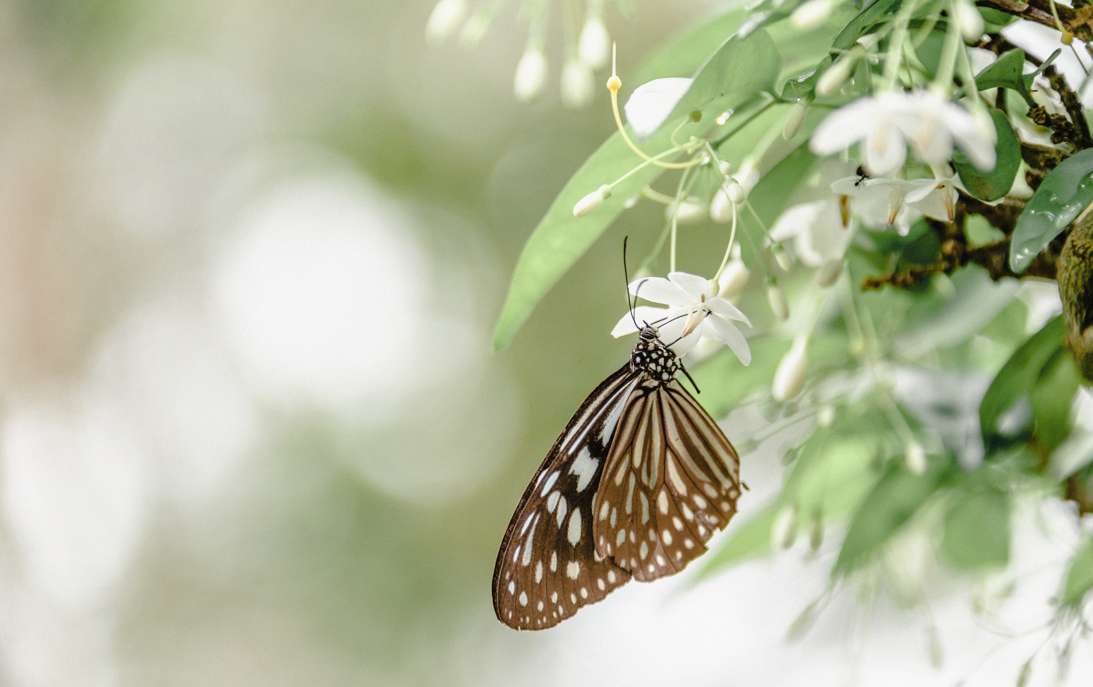




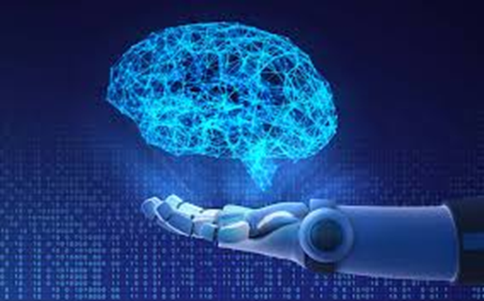
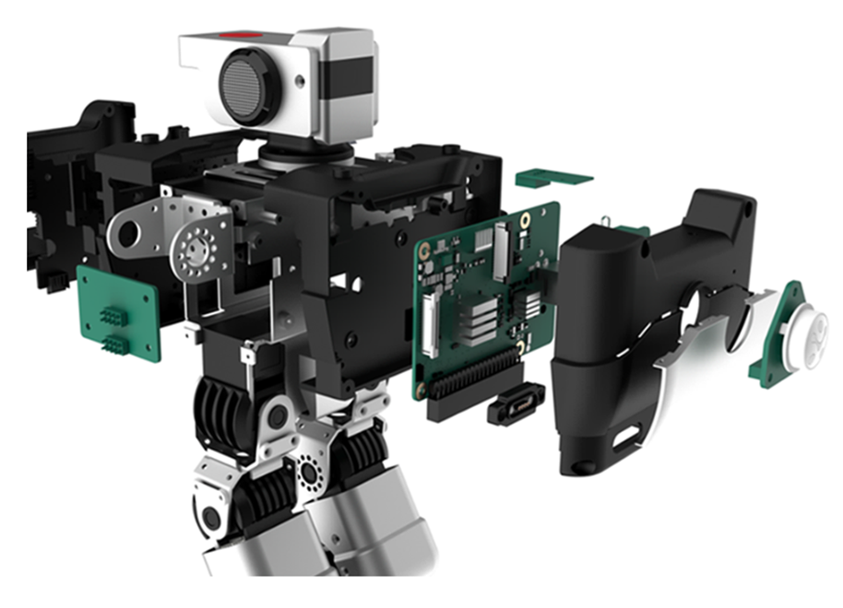

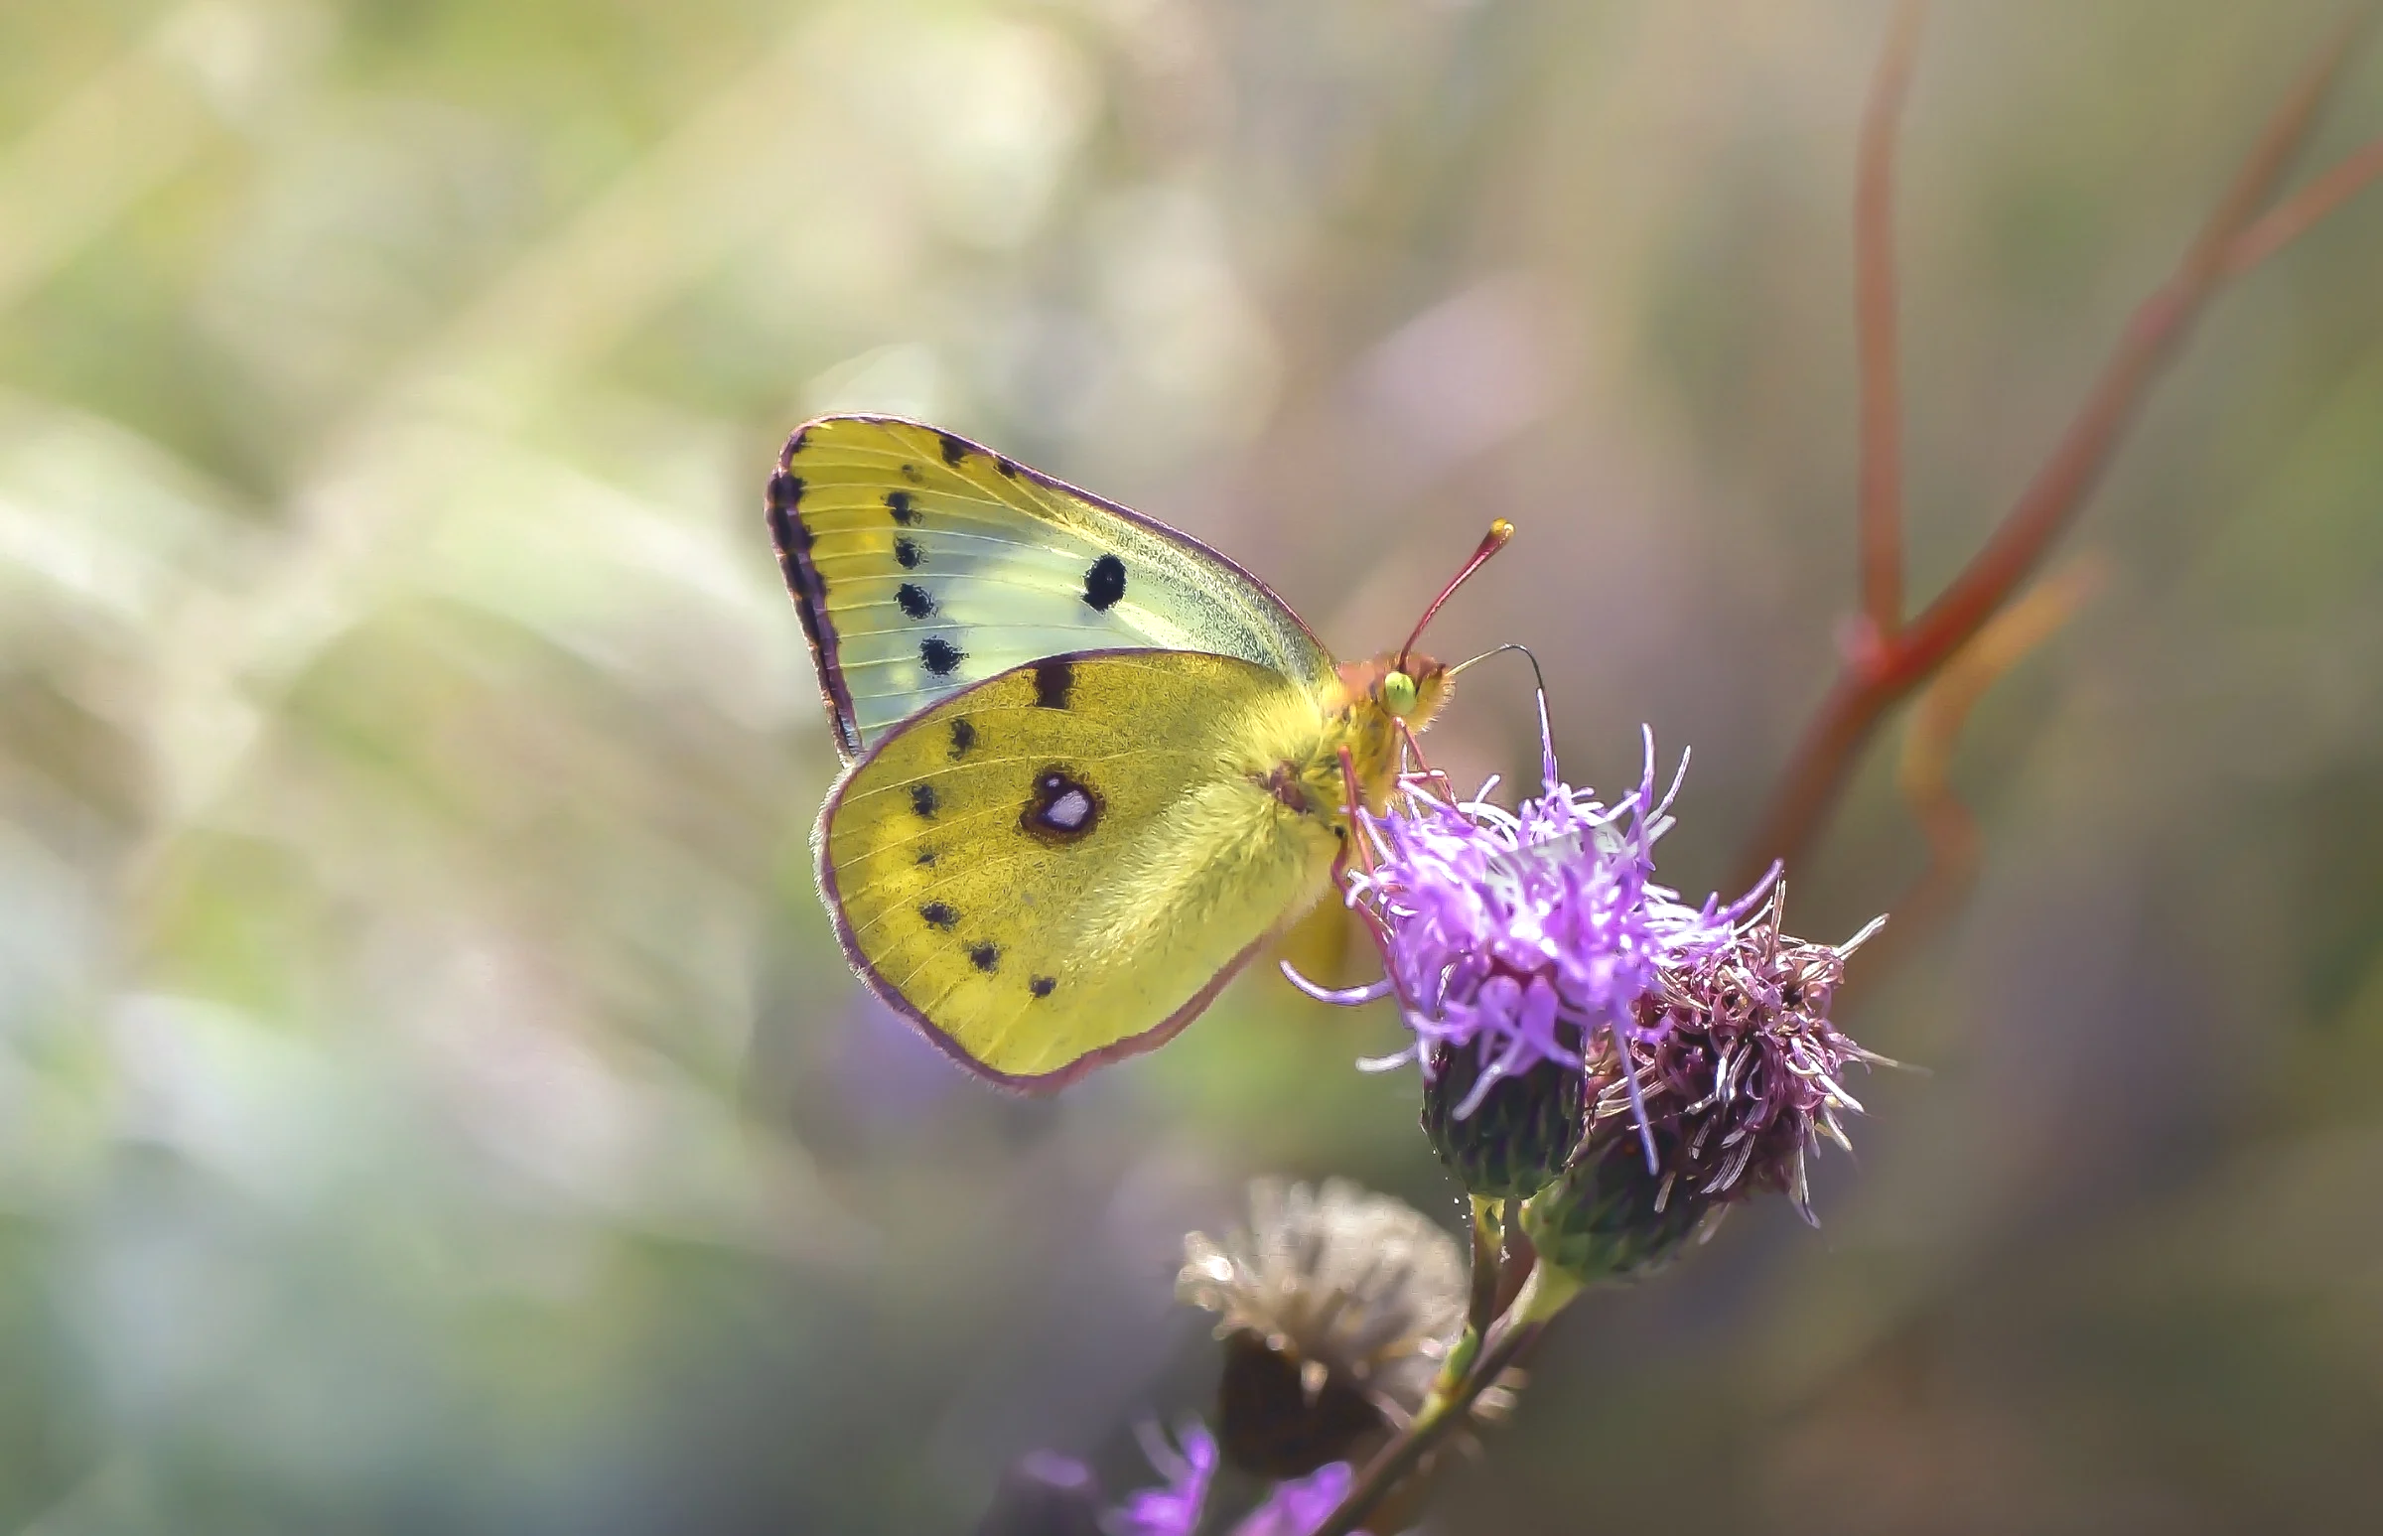
Exploring Emerging Technologies: Applying Artificial Intelligence Methodologies
Jane Kasmara and Dr Jessica Turner
Department of Computer Science, University of Waikato
jrk36@students.waikato.ac.nz
INTRODUCTION
The CSNeT programme at the University of Waikato’s Tauranga Campus has been a key initiative in introducing high school students to fundamental computing skills such as programming and graphical user interfaces. As interest grows in AI, Artificial Intelligence and computer vision, the programme is expanding to include hands-on learning with advanced robots like the Create 3 and Yanshee, ensuring students stay engaged with cutting-edge technology.
OBJECTIVE
The project focused on creating a Level 5 Artificial Intelligence Series to the CSNeT programme, which includes six interactive sessions covering AI and robotics. Another key part of the project is “Battle of the Bytes,” a quiz competition designed for high school students from Year 9 through to Year 13.
METHODOLOGY
These two robots were programmed in Python. Open-source software was used to program Buddy, including Blockly and Jupyter, while we programmed Bot Marley using Web Playground v1.2.3
PRACTICAL USE CASES
AI APPLICATION
Birthday acknowledgements and
Festival celebrations where multiple robots can be programmed for synchronous dance
Open Day events - O-Week showcase promoting computer science in an engaging manner
This project brought AI concepts to life through hands-on experience. By working with these robots, we were able to create music notes and dance moves which trained AI to recognise rhythms, much like how it identifies faces, gestures and objects. AI memory helps machines ‘remember’ and improve, similar to how humans study and recall.
AI finds patterns in data
RESULTS
Scan the QR code to access the Level 5 Artificial Intelligence Series teaching materials, along with some of its source code and recordings of work outcomes.
AI memory similar to how humans’ study and recall
CONCLUSION
With some more programming and exploration of ROS, Linux and C++, future work can be undertaken to solidify the computer vision capabilities such as face recognition, object detection and memory systems
References
[1] J. Kahila, H. Vartiainen, M. Tedre, E. Arkko, A. Lin, N. Pope, I. Jormanainen, and T. Valtonen, "Pedagogical framework for cultivating children’s data agency and creative abilities in the age of AI", Informatics in Education.,vol.23, no. 2, pp. 323-360, Jun. 2024, doi: 10.15388/infedu.2024.15.
[2] iRobot, “Create 3 Getting Started.” irobot.com. Accessed: Nov.18, 2024. [Online.] Available: https://edu.irobot.com/learning-library/create-3-getting-started .
[3] UBTECH Robotics, “Yanshee Getting Started.” ubtrobot.com. Accessed: Jan. 20. [Online.] Available:
https://yandev.ubtrobot.com/#/en
[4] K.Kargin,”Computer vision introduction.” medium.com. Accessed: Jan. 13, 2025. [Online.] Available: https://keremkargin.medium.com/computer-vision-fundamentals-and-opencv-overview-9a30fe94f0ce .

